Slide 1
Supply Chain Cybersecurity
Charles Wilson
Technical Fellow, Cybersecurity Engineering
Motional
version 3
2024-03-12
Notes:
Script:
I’m Charles Wilson, Technical Fellow at Motional responsible for cybersecurity development lifecycle practice. This presentation will cover supply chain cybersecurity.

Slide 2
AVCDL
Notes:
Script:

Slide 3
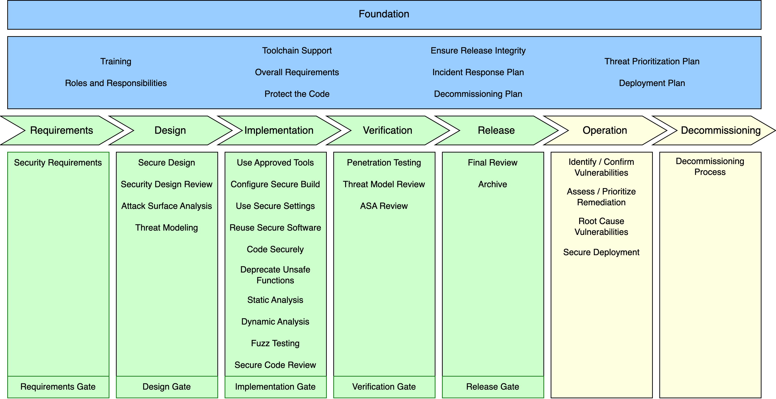
AVCDL Framework
Notes:
Script:

Slide 4
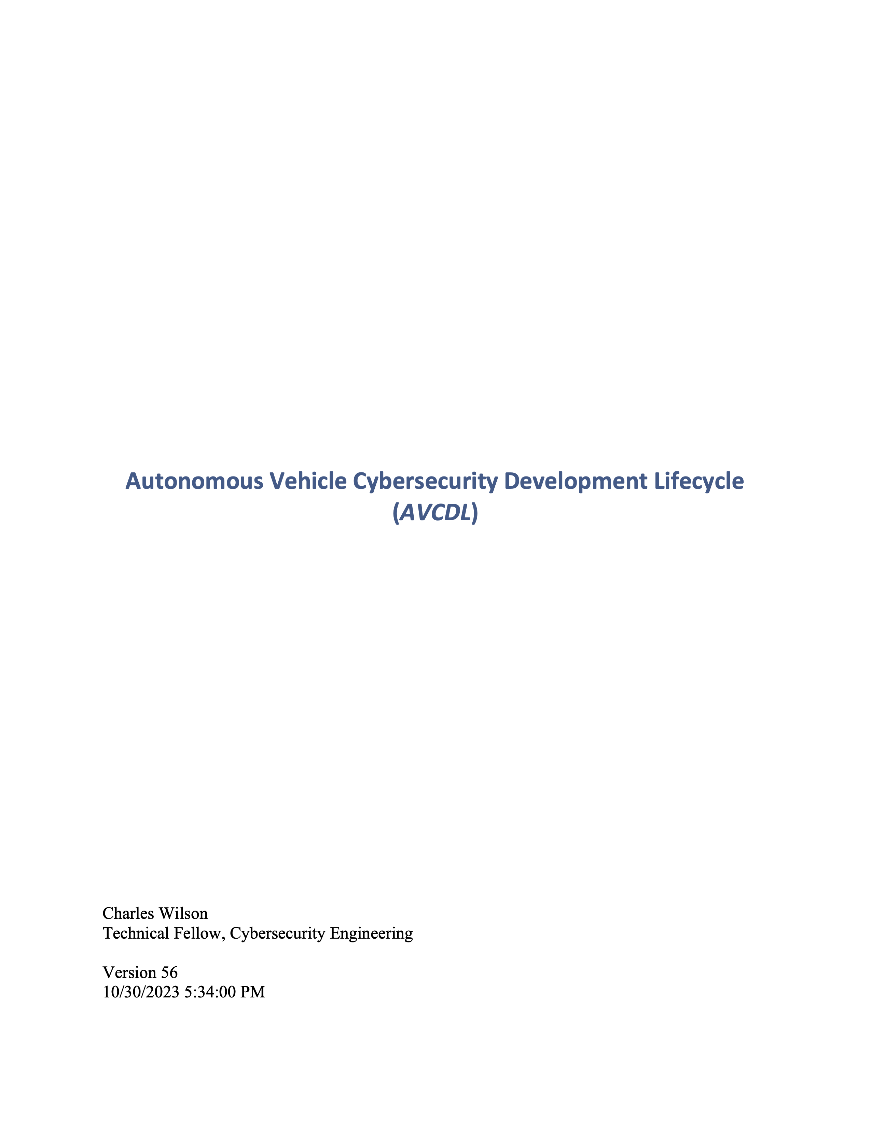
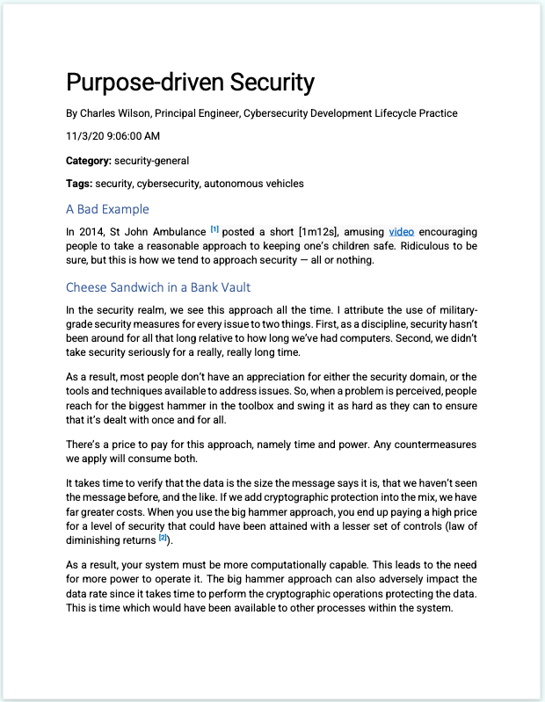
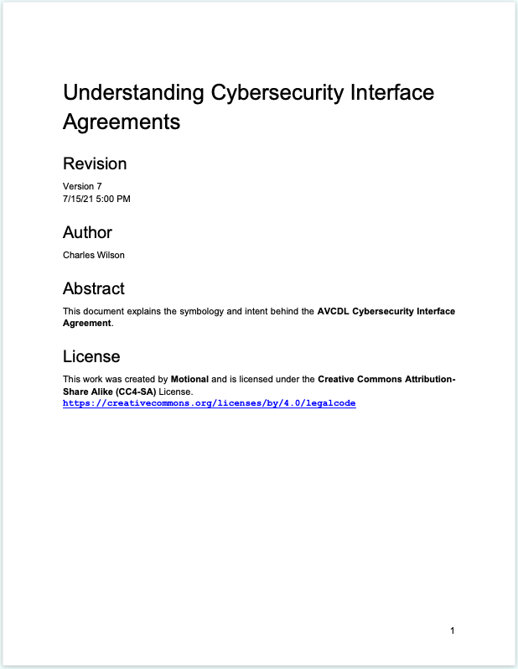
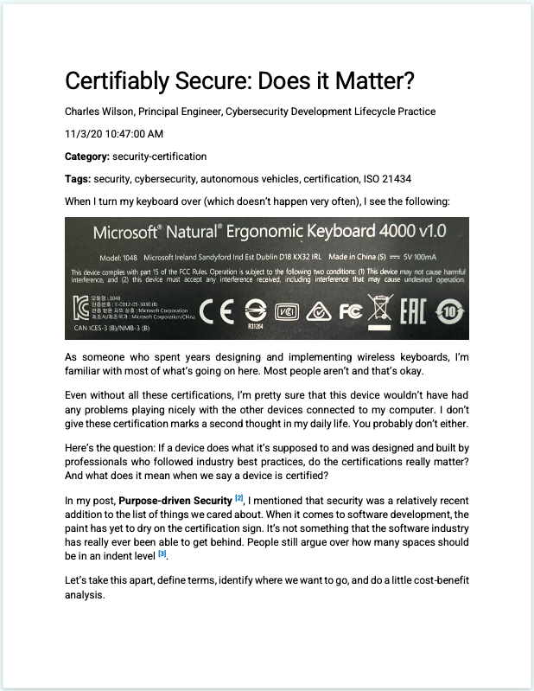
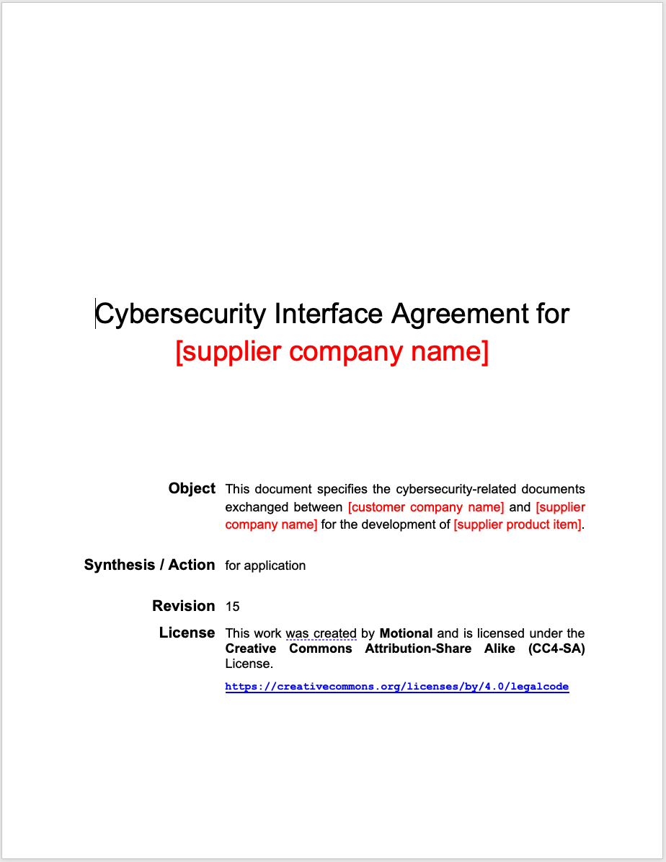
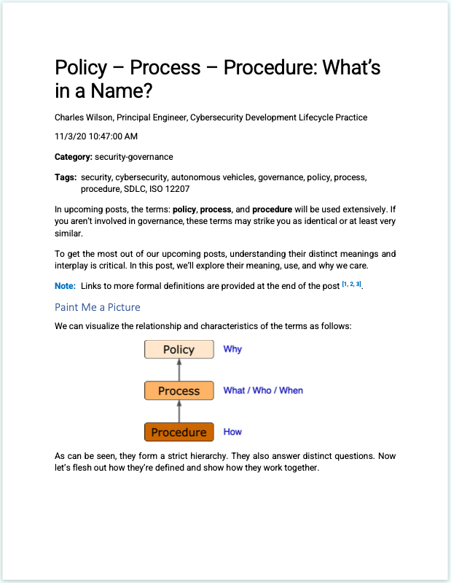
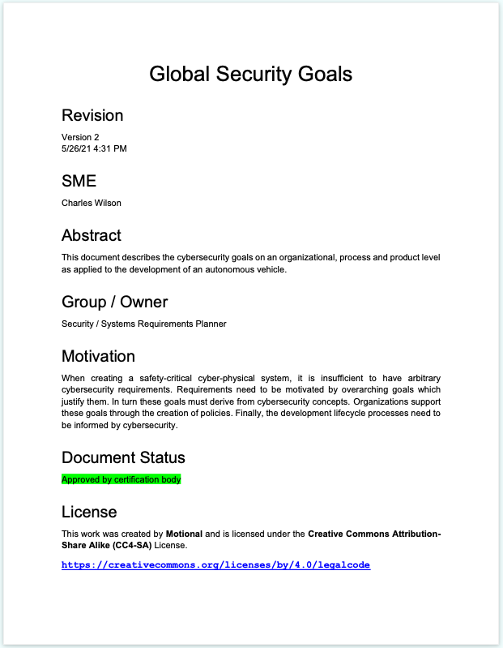
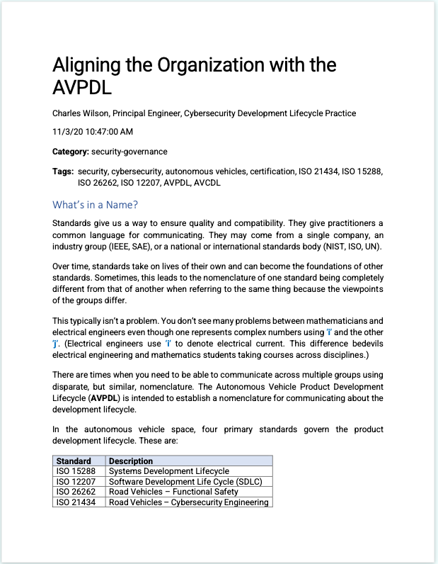
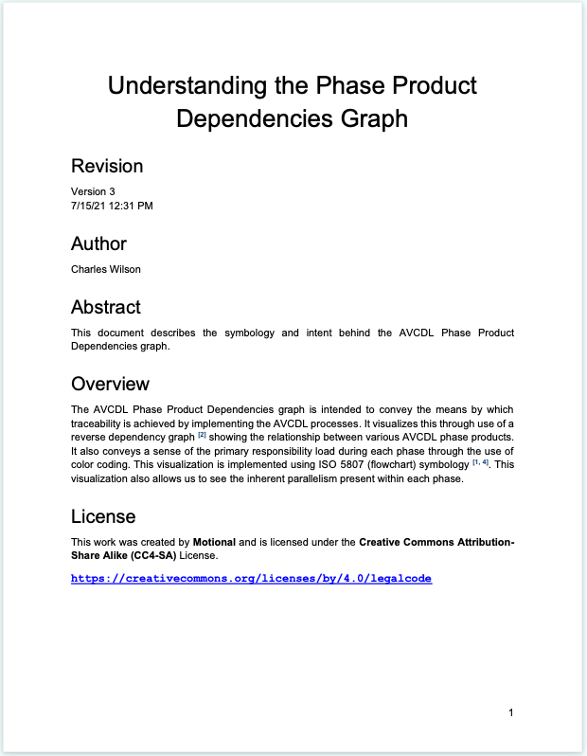
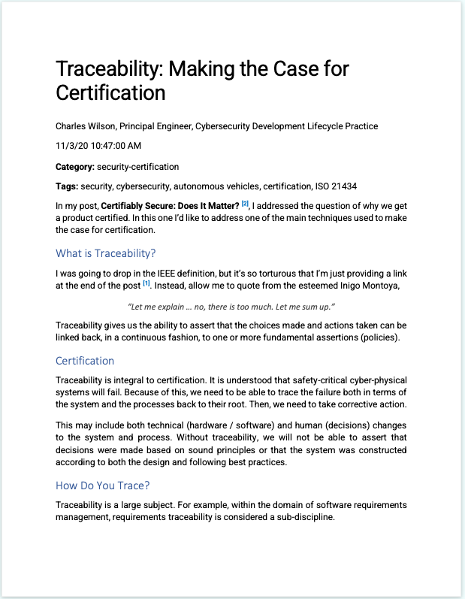
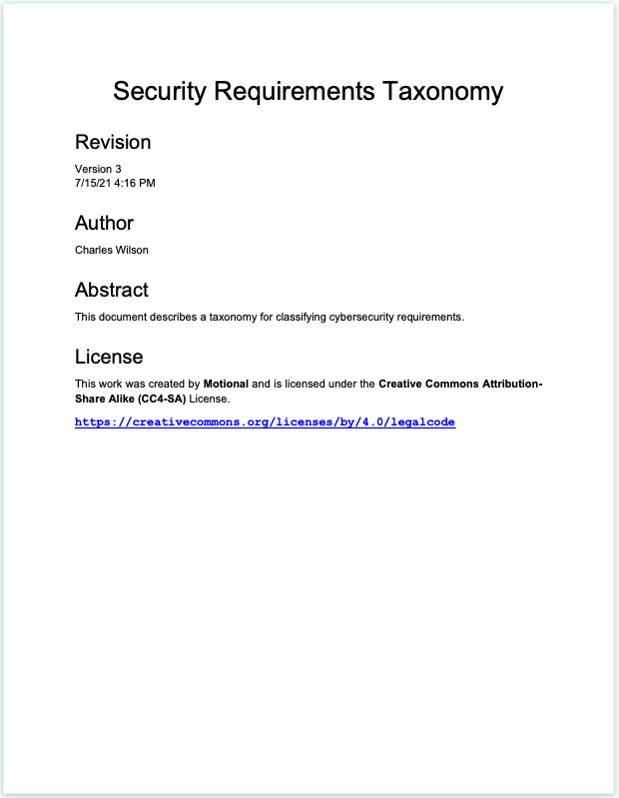
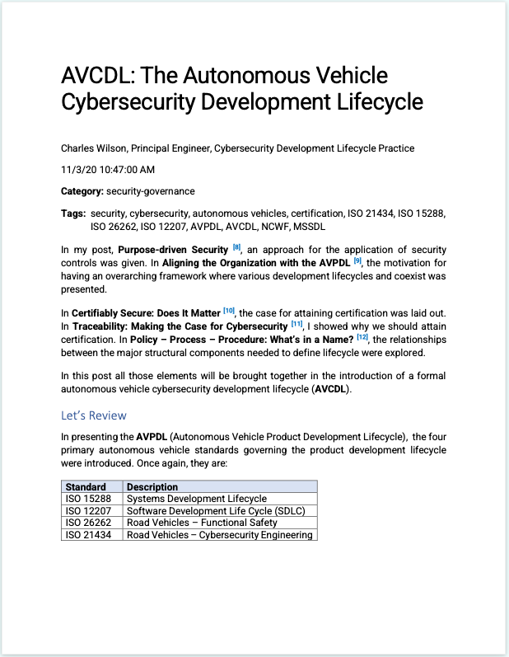
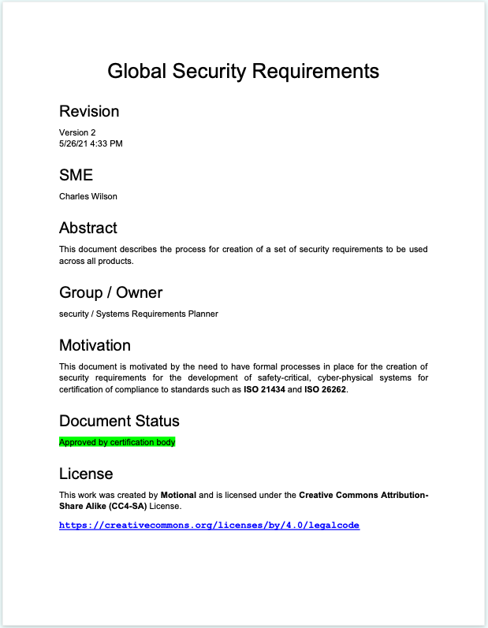
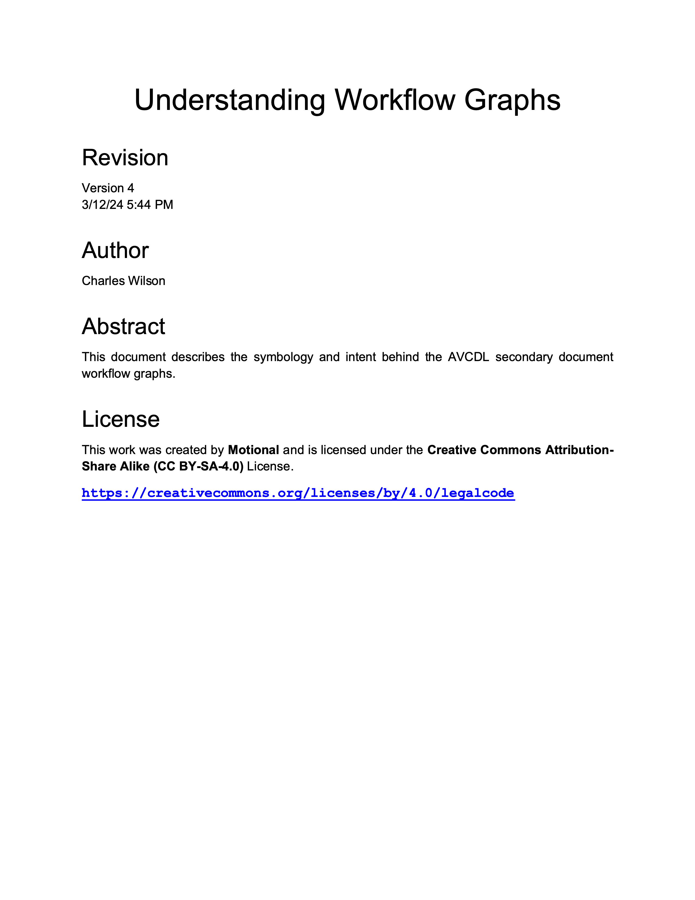
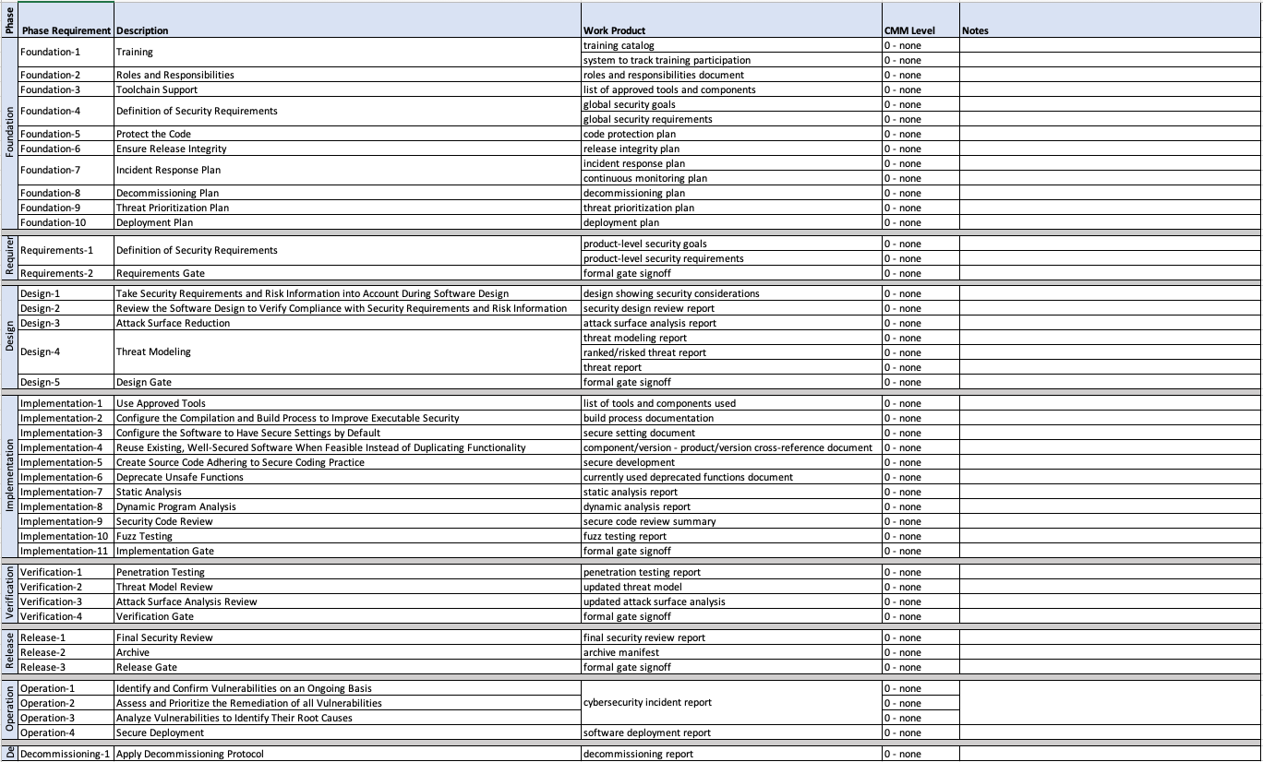
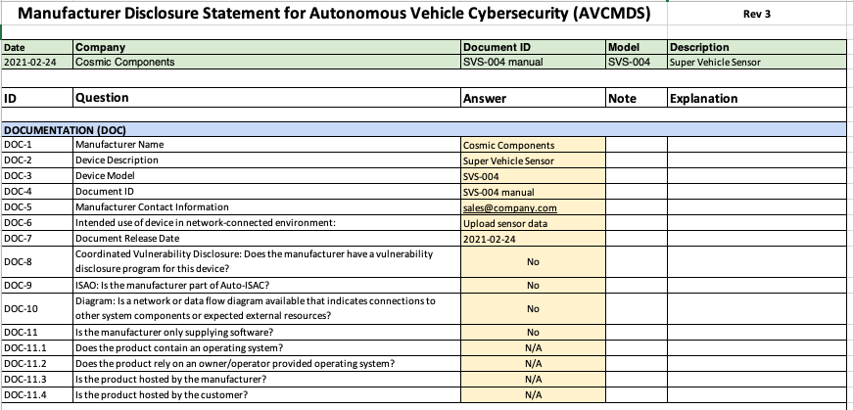
AVCDL Materials
Notes:
Script:

Slide 5
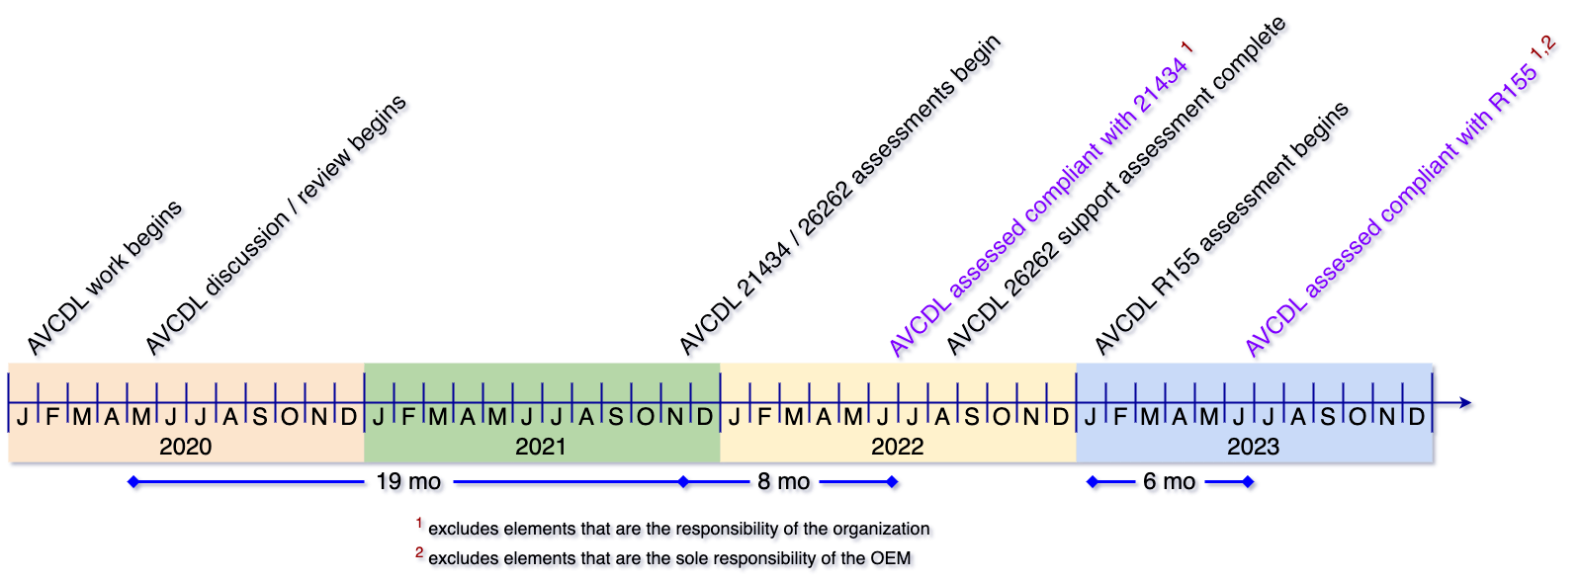
Assessment Timeline
Notes:
Script:

Slide 6
Standard and Regulations
Notes:
Script:

Slide 7
Standards and Regulations Ecosystem
EU Ares Proposal
(ADS)
Automated Driving Systems will require conformance to R155 and R156
UN R157
(ALKS)
Auto Lane Keeping Systems must conform to R155 and R156
UN R156 (SUMS)
Software Update Management Systems aligned with 24089 and 21434
ISO 24089
(software update)
UN R155 (CSMS)
Cybersecurity Management Systems aligned with 21434
ISO/SAE 21434
(CySec engineering)
ISO 12207 (SDLC - software)
System and software development lifecycles
ISO 15288 (SDLC - system)
ISO 9001 / IATF 16949 (QMS)
A certified QMS is the basis for compliance
Standard
Regulation
Future
Notes:
Script:

Slide 8
R155 At a Glance
Category | Description | Responsibility
 |  | OEM | Supplier
General | UN regulation boilerplate | N/A
CSMS * | Product creation processes | Owner | Support
Vehicle Type | Product operation processes
Reporting | Product issue processes
* CyberSecurity Management System
Notes:
Script:
Let’s consider the general categories covered by UN R155. The first is general material covering the UN boilerplate. The second is the cybersecurity management system or CSMS which deals with the product creation process. The third, vehicle type or product operation processes. Fourth is reporting which deals with product issue processes. R155 doesn’t just focus on the OEM, although the OEM is primarily responsible for ensuring compliance. There is an expectation within R155 that the entire supply chain conforms to the regulation, regardless of the supplier tier.

Slide 9
R155 Supply Chain Scope
Approval Authority
OEM
distribution of work and data sharing through agreed upon ISO/SAE 21434-compliant
cybersecurity interface agreements
Tier 1
Tier 2
Requirements
Evidence
Approval
Notes:
Script:
Here we see an illustration of how a R155 supply chain showing various information flows. The OEM generates requirements for its tier 1 suppliers. The tier 1 suppliers in turn generate requirements for all of their lower tier suppliers. All suppliers are expected to provide evidence supporting their fulfillment of the requirements and their compliance with R155. This evidence accumulates as it feeds up the supply chain. Eventually, when the product is ready for certification, the OEM organizes the accumulated evidence and provides it to the approval authority.
If the evidence is compelling, the approval authority provides an approval of the type to the OEM. Measurement and control of requirements and evidence is established in the agreements between each customer and their supplier regardless of their position in the supply chain. The controlling agreement within the context of ISO/SAE 21434 is called a cybersecurity interface agreement or CIA.

Slide 10
R155 Requirements
Fundamentals
Operation
development phase CSMS
production phase CSMS
post-production CSMS
adaptable monitoring and response
cybersecurity controls tracking
timely risk mitigation
threat extraction from vehicle logs
supplier deficiency management
Product Development
OEM Support
risk identification
risk assessment and treatment
verification of risk management
cybersecurity testing
risk assessment kept current
critical element risk assessment
type risk protection
type risk countermeasures
sufficient testing
detect and prevent cyber attacks
vehicle cybersecurity monitoring
provide forensic capability
Notes:
Script:
Implementation of R155 can be divided into four areas.
The first is fundamentals. This area is concerned with management systems. These systems track and document the evidence we have for the various activities we do. Management systems are expected to exist for development, production, and postproduction activities.
The second area is product development. In this area deals with risk identification, assessment, and treatment; the verification of the management of risk; cybersecurity testing; and most importantly, the freshness of the risk assessment.
It’s critical that this information is kept up-to-date.
The third area is that of operations, it’s important that to have adaptable monitoring and response. It’s not sufficient just to have a set of rules in place for when the product is in operation.
You have to be able to adapt to changing situations that occur over the lifetime of the vehicle. To that end, the focus is on tracking the cybersecurity controls used.
Also, it’s necessary to ensure that the risk mitigations in place are implemented in a timely fashion.
It’s important to be able to do threat extraction from the vehicle logs. Are the right pieces of information being recorded that will identify when a cybersecurity related activity or incident happens, such that you can use the information for both diagnostic and mitigation purposes?
Are supplier deficiencies being managed? This must be done regardless of what tier you’re in. Are you tracking to make sure that your suppliers are doing the right things when cybersecurity issues arise?
The fourth area addresses support the suppliers provide to the OEM. The entire supply chain needs to be supporting the OEM since they are the party being held responsible. Shared activities like the critical element risk assessment, the type risk protection, the risk countermeasures, and sufficiency testing are all examples of areas where support is needed. All suppliers need to ensure that they are doing everything reasonable to detect and prevent cyberattacks. After releasing to their customer, suppliers need to monitor for cybersecurity events that occur and need to provide the ability to extract forensic information from their logs.

Slide 11
Supplier Selection
Notes:
Script:

Slide 12
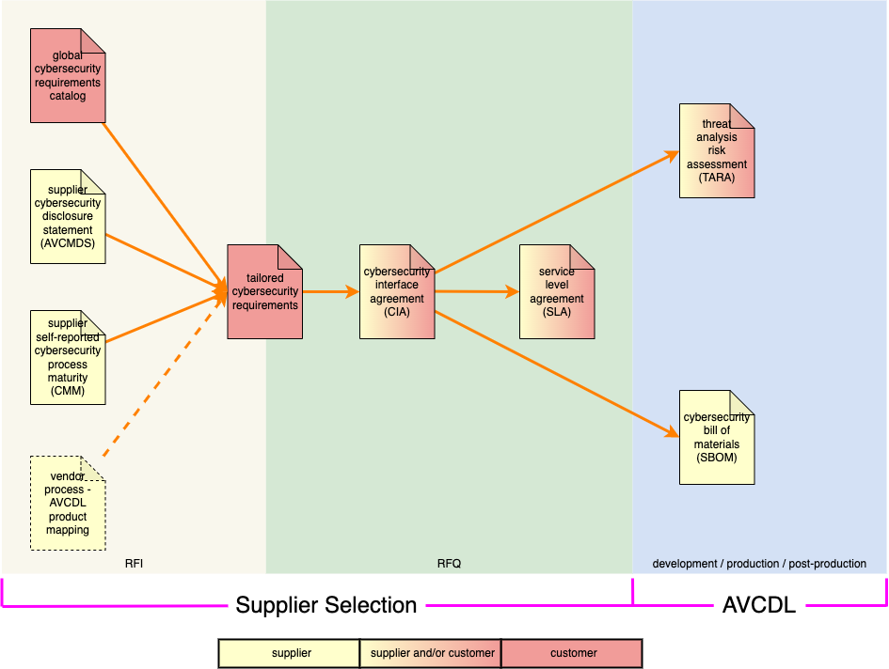
Supplier Selection
Notes:
Script:
Here we can see how various documents key to supply chain cybersecurity relate and where in the supplier selection process they live.

Slide 13
Supplier Cybersecurity Manufacturer Disclosure Statement
Notes:
Script:

Slide 14
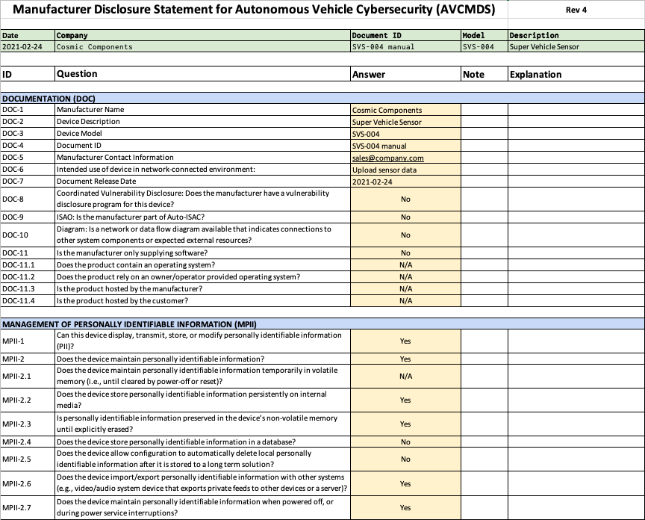
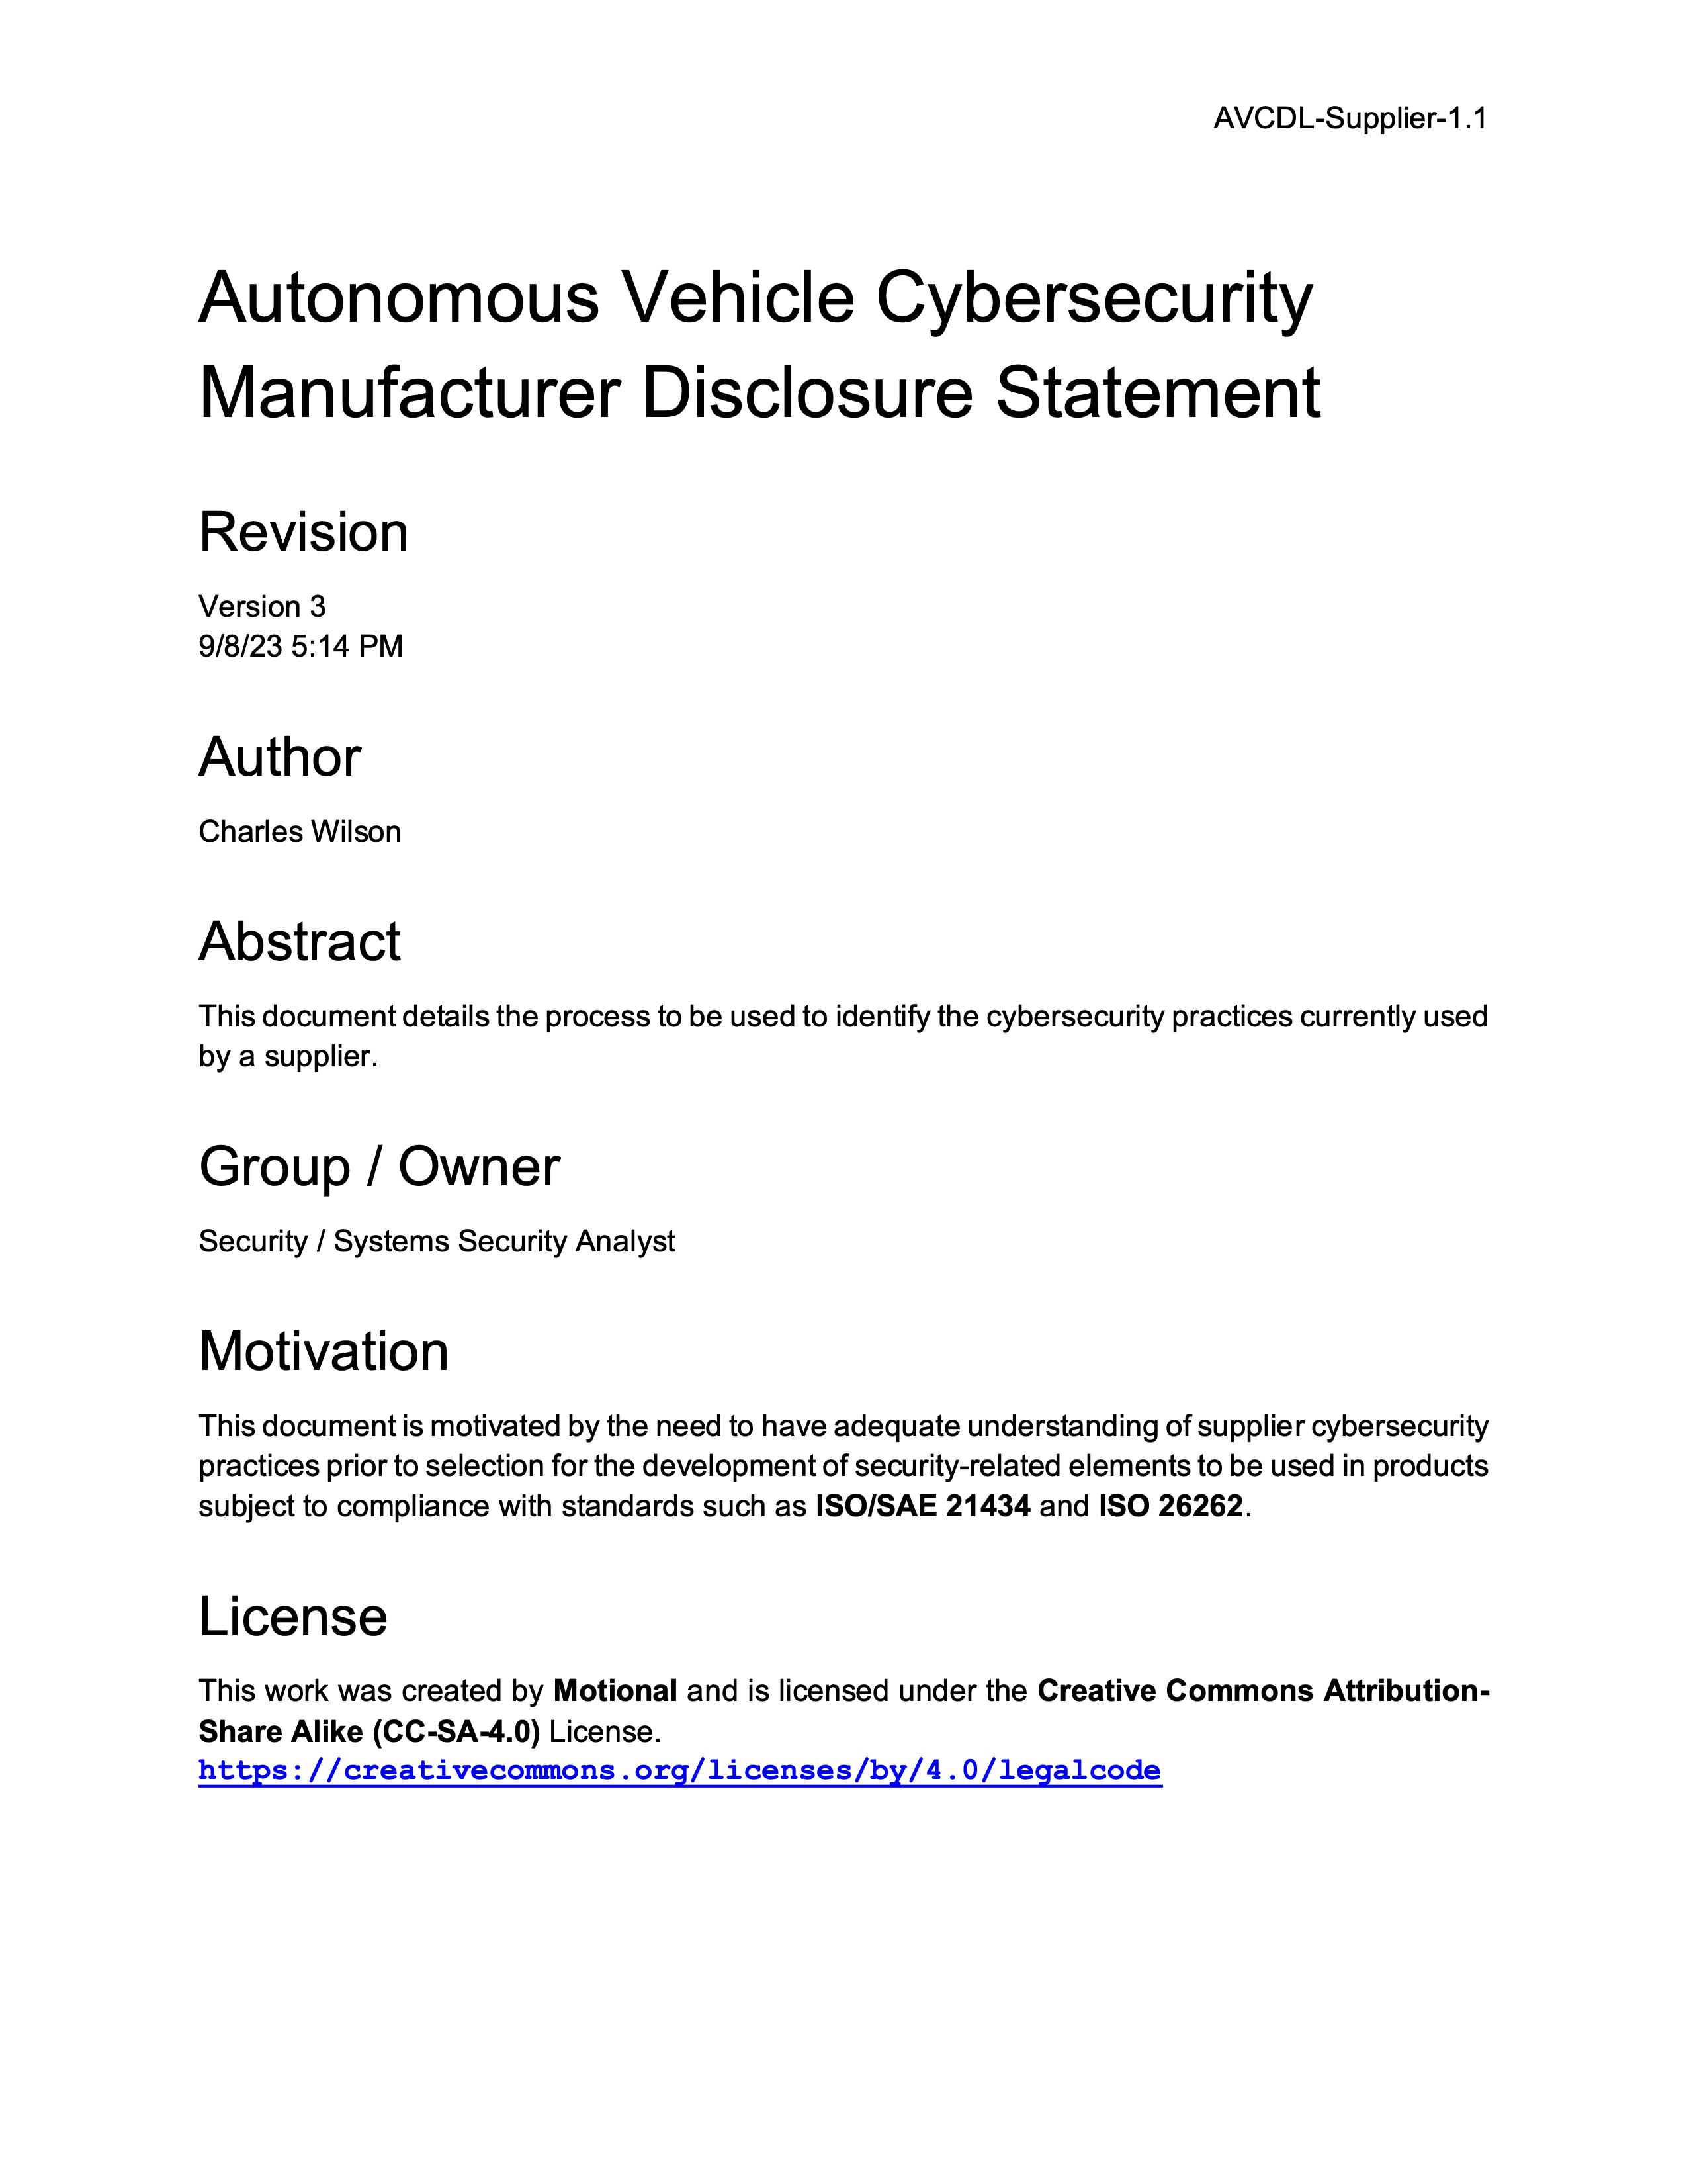
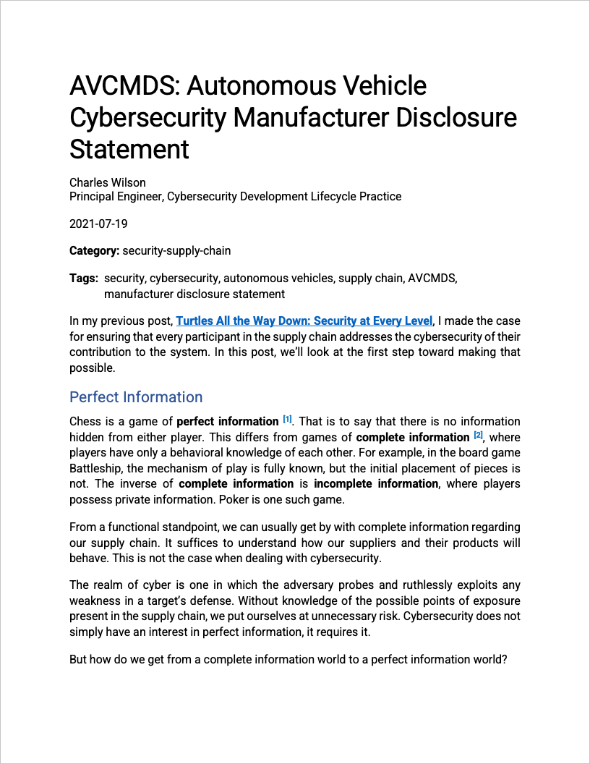
AVCMDS Material
Notes:
Script:
There are three documents within the AVCDL document set that support the creation of the AVCMDS.
These are
the Autonomous Vehicle Cybersecurity Manufacturers Disclosure Statement secondary document
the blog post AVCMDS Autonomous Vehicle Cybersecurity Manufacturers Disclosure Statement
and the Manufacturers Disclosure Statement for Autonomous Vehicle Cybersecurity AVCMDS template.

Slide 15
Worksheet Topics
Documentation
PII management
Automatic logoff
Audit controls
Access controls
Product upgrading
Data de-identification
Data backup
Disaster recovery
Data integrity / authenticity
Malware handling
Device authentication
Device connectivity
User authentication
Physical security
Device lifecycle management
Software bill-of-materials (SBOM)
Hardening
Security guidance
Data storage confidentiality
Data transmission confidentiality
Data transmission integrity
Connectivity / remote access
Other
Notes:
Script:
The AVCMDS worksheet covers 24 topics.
They're listed here.
Rather than read them off, I’ll leave them on the screen for a bit and give you some time to look them over.

Slide 16
Supplier Cybersecurity Maturity
Notes:
Script:

Slide 17
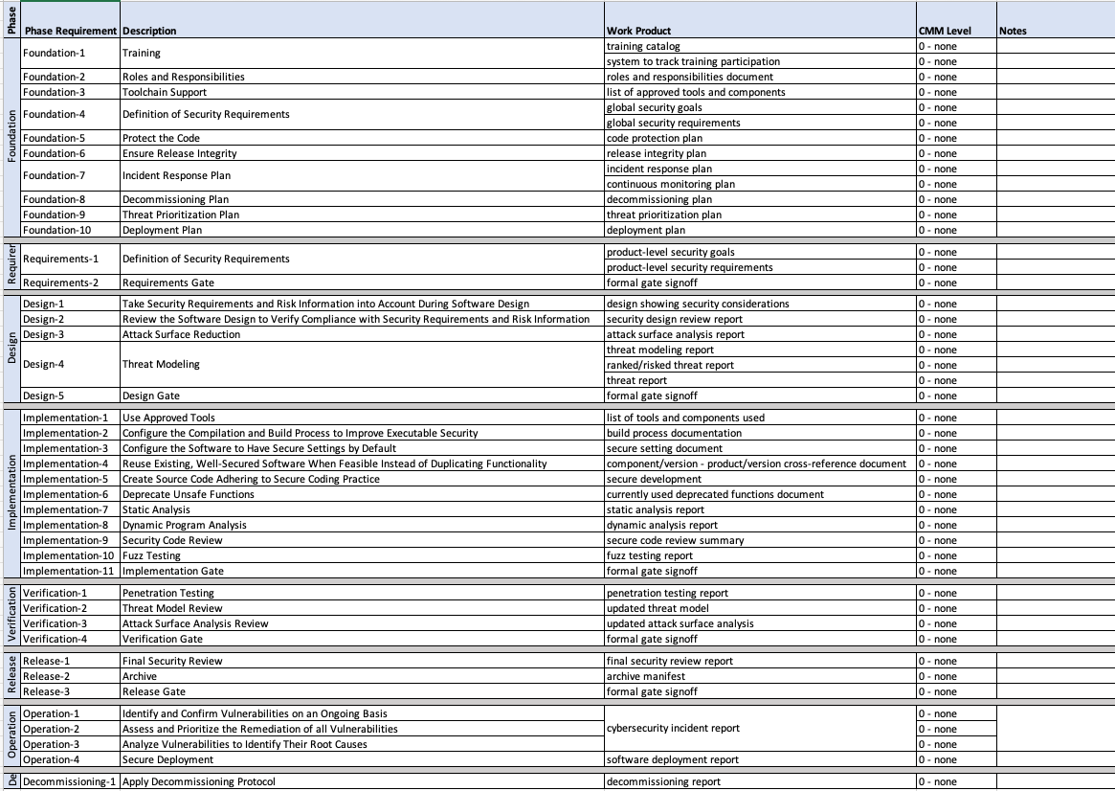
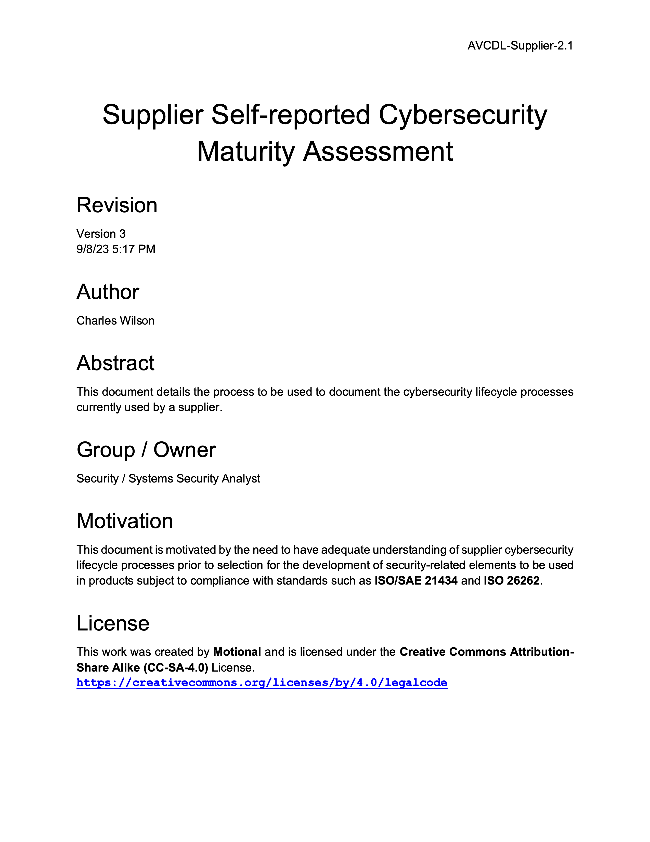
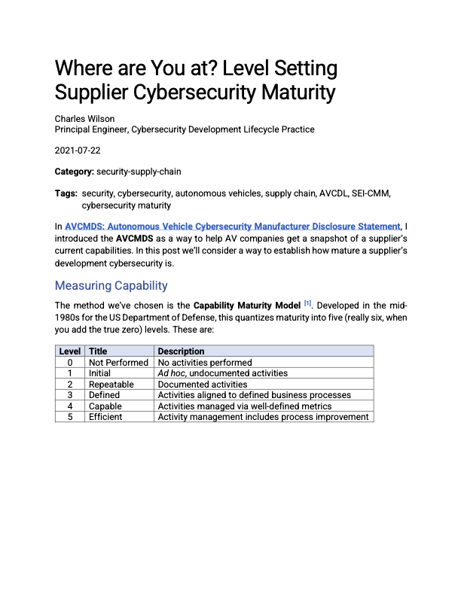
Supplier Self-reported Maturity Material
Notes:
Script:
There are three documents within the AVCDL document set that support the creation of the supplier’s self-report maturity.
These are
the Supplier Self-reported Cybersecurity Maturity Assessment secondary document
the blog post Where are You at? Level Setting Supplier Cybersecurity Maturity
and the AVCDL vendor CMM template spreadsheet.

Slide 18
Not Enough vs. Too Much *
Risk
Excessive
Risk Taking
CMM 5
Continuously
Improving
Optimal
Perceived Value
Negligence Threshold
CMM 4
Quantitatively
Controlled
Diminishing
Perceived Value
Process Review Lag
Little or No
Oversight
CMM 3
Well-Defined
Optimal
Risk Taking
Cost and Complexity
CMM 2
Planned & Tracked
Annual
Reviews
CMM 1
Performed
Informally
Monthly / Quarterly
Reviews
Near Real-time
Reviews
(AI/ML-driven)
Stakeholder Value
CMM 0
Not
Performed
Non-existent
Practices
Ad Hoc
Practices
Requirements-Driven
Practices
Enterprise-Wide
Standardization
Metrics-Driven
Governance
World-Class
Practices
Maturity Level (People, Processes & Technology)
* CMM level and CMM Sweet Spot images (link in references)
Notes:
Script:

Slide 19
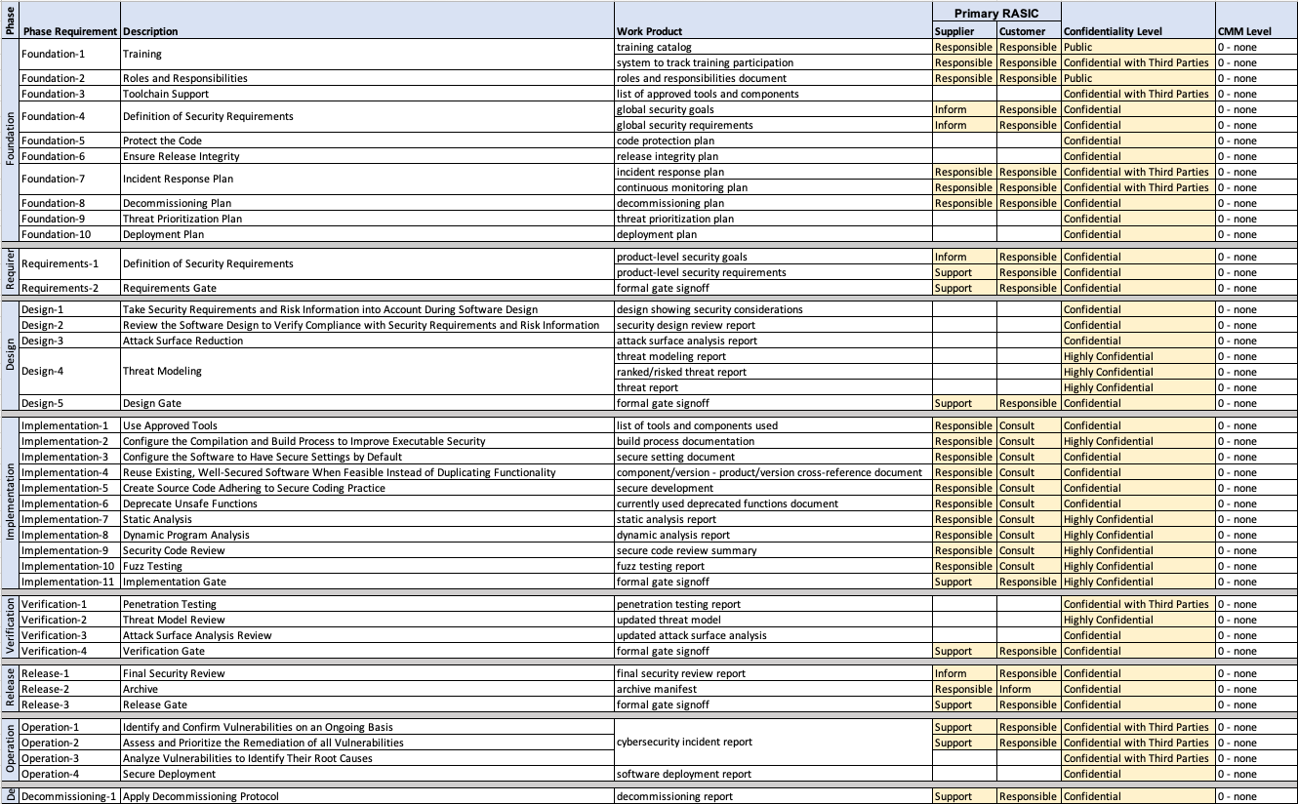
Maturity Summary
Notes:
Script:
We can track the maturity using the AVCDL cybersecurity interface agreement summary template, spreadsheet.
This spreadsheet includes is a column for the CMM level.
Additional information of the RASICs and confidentiality level can be ignored in the context of the supplier’s cybersecurity maturity.
To track this information over time, the sheet can be duplicated with each new sheet having the time stamp of the assessment being included on it.
This material can then be used to form a series of charts depicting visually how the cybersecurity posture of the supplier is changing over time.

Slide 20
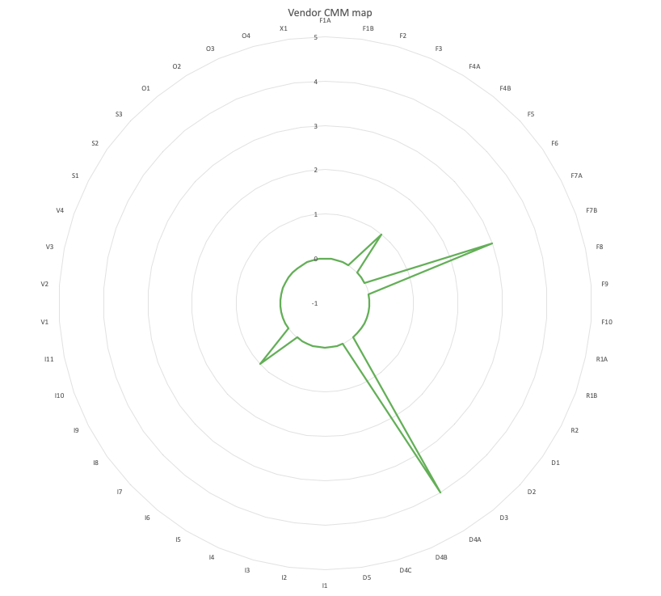
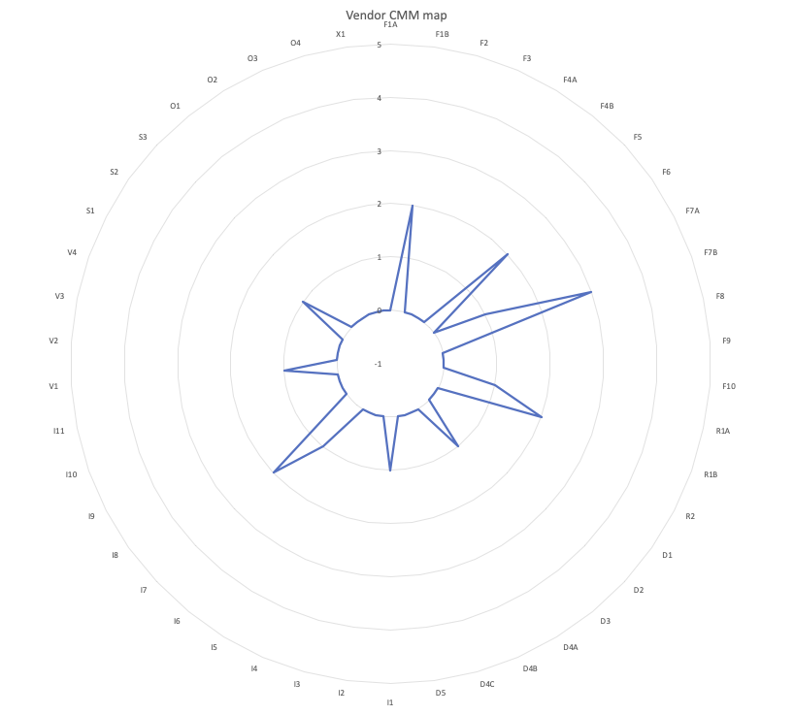
Visualizing Progress
Notes:
Script:
Over time, we can take these data series and overlay them to get a good idea of the dynamics of the progress that an organization is making,
both advancing and regressing in terms of their cybersecurity posture.

Slide 21
Supplier Cybersecurity Process Mapping
Notes:
Script:

Slide 22
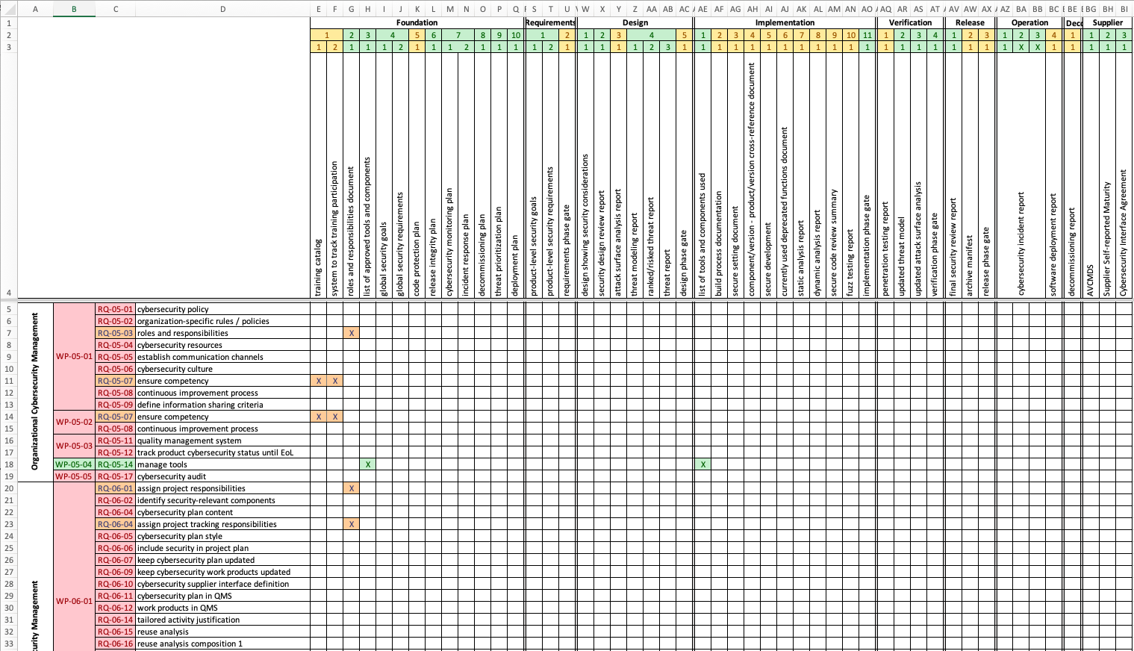
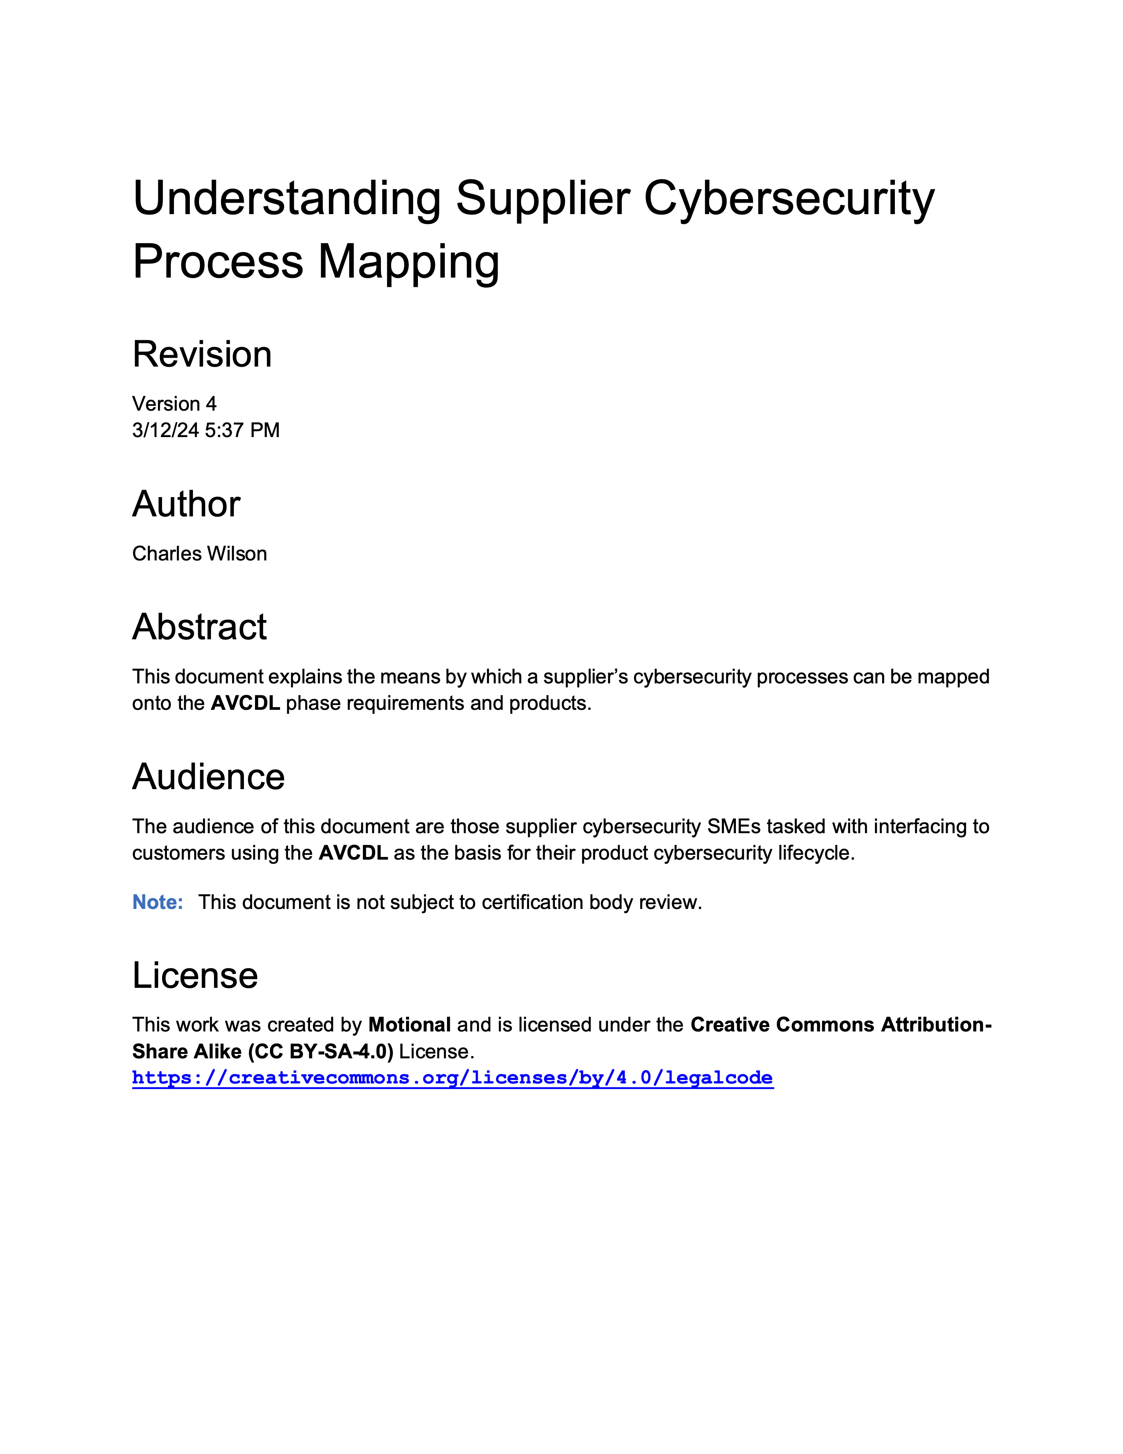
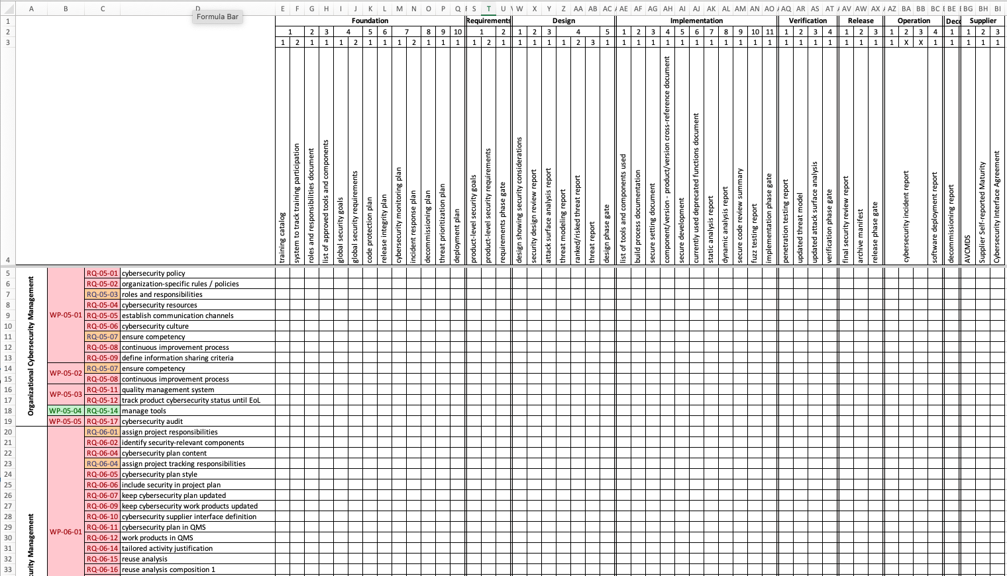
Process Mapping Material
Notes:
Script:
There are three documents within the AVCDL document set that support the creation of the supplier process to AVCDL requirement product mapping.
These are
the Understanding Supplier Cybersecurity Process Mapping elaboration document
the 434 req-AVCDL product sheet of the vendor process - AVCDL product mapping template spreadsheet workbook
And the 434 req-vendor process sheet of the vendor process - AVCDL product mapping template spreadsheet workbook

Slide 23
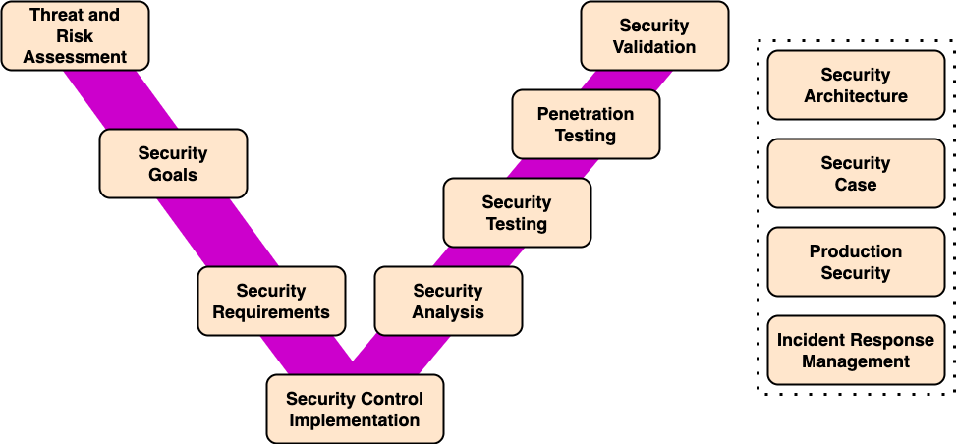
Supplier Processes
Notes:
Script:
Here's a typical set of supplier processes.
You'll note that it's using the classic V-diagram that we see so often.
Although easy to understand, its processes are very general.
Also, they don’t directly map to the AVCDL or 21434 for that matter.

Slide 24
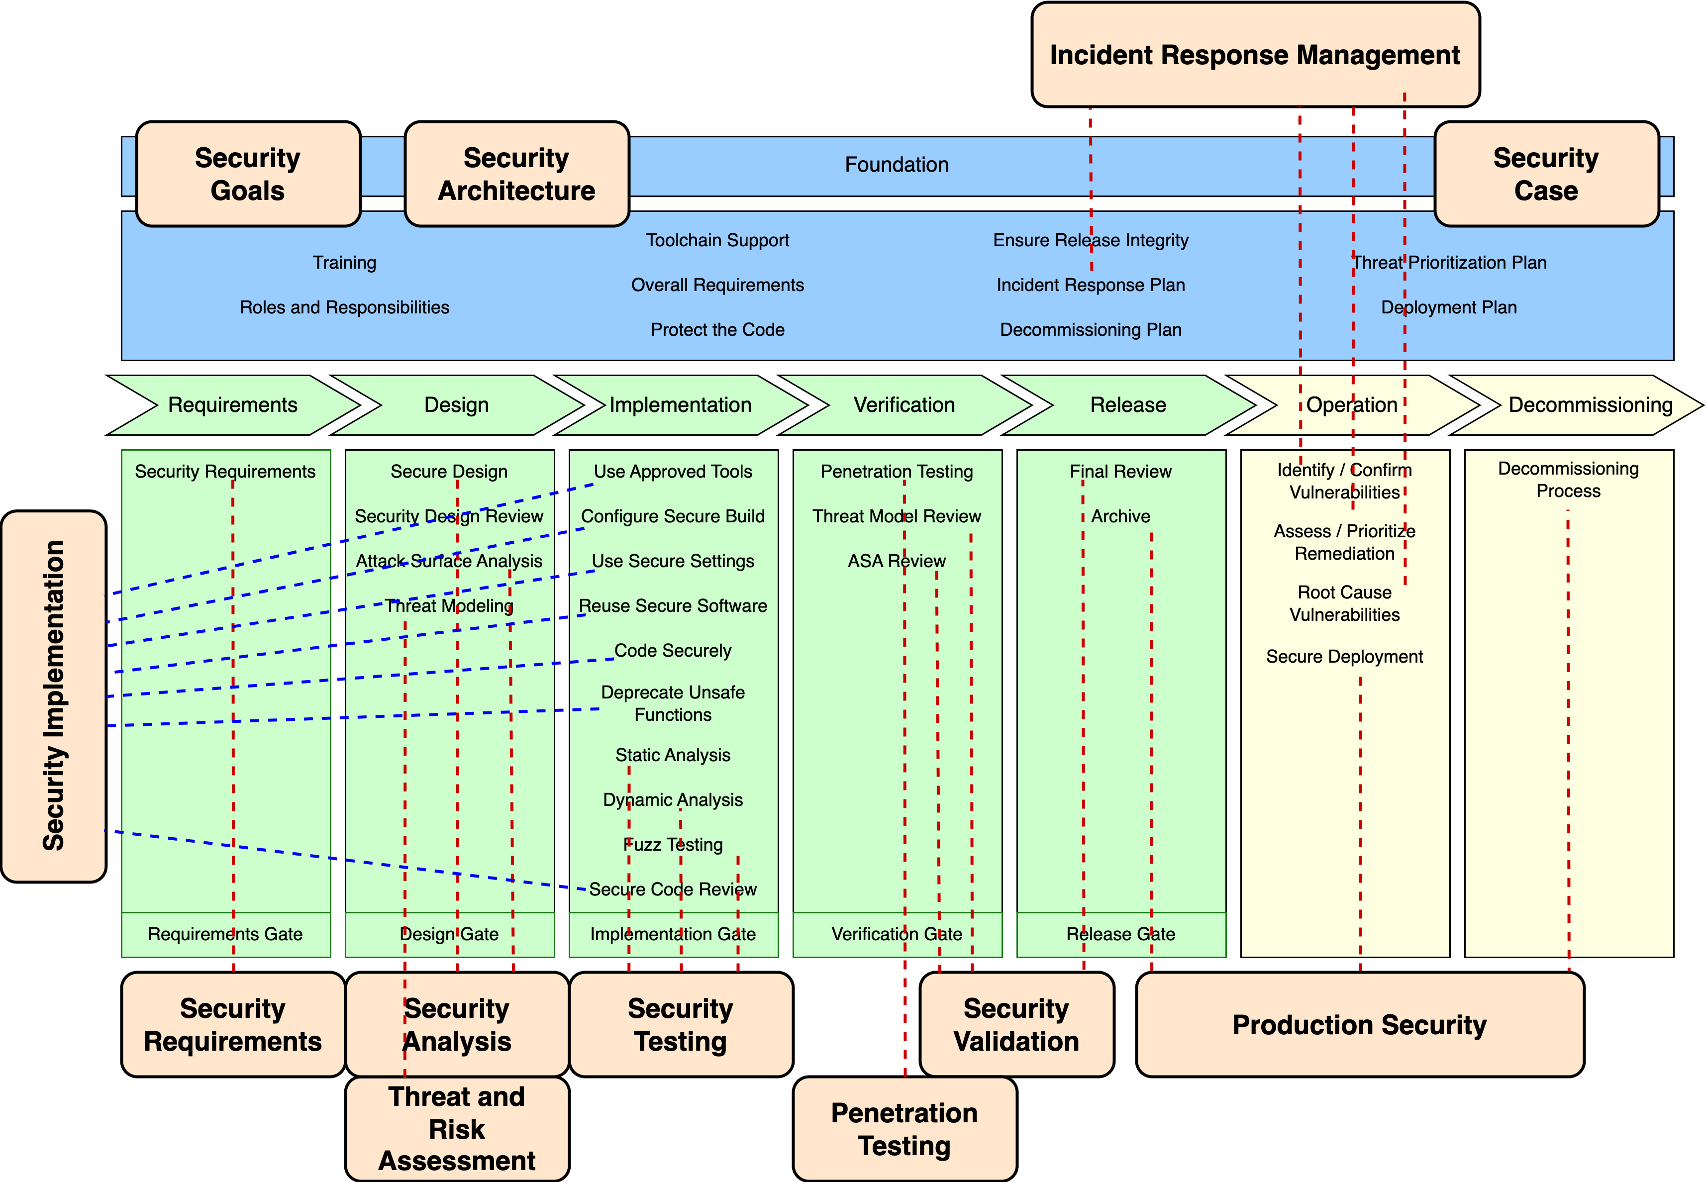
Supplier Processes Overlay
Notes:
Script:
If we overlay the supplier processes onto the AVCDL, the complexity that arises becomes very evident.
Many of the supplier processes cover multiple AVCDL processes.
In order for a supplier using their processes and a customer using the AVCDL (or vise versa) to communicate, there needs to be a clear and defined mapping between these two disparate approaches.

Slide 25
Where to Go From Here
Notes:
Script:

Slide 26
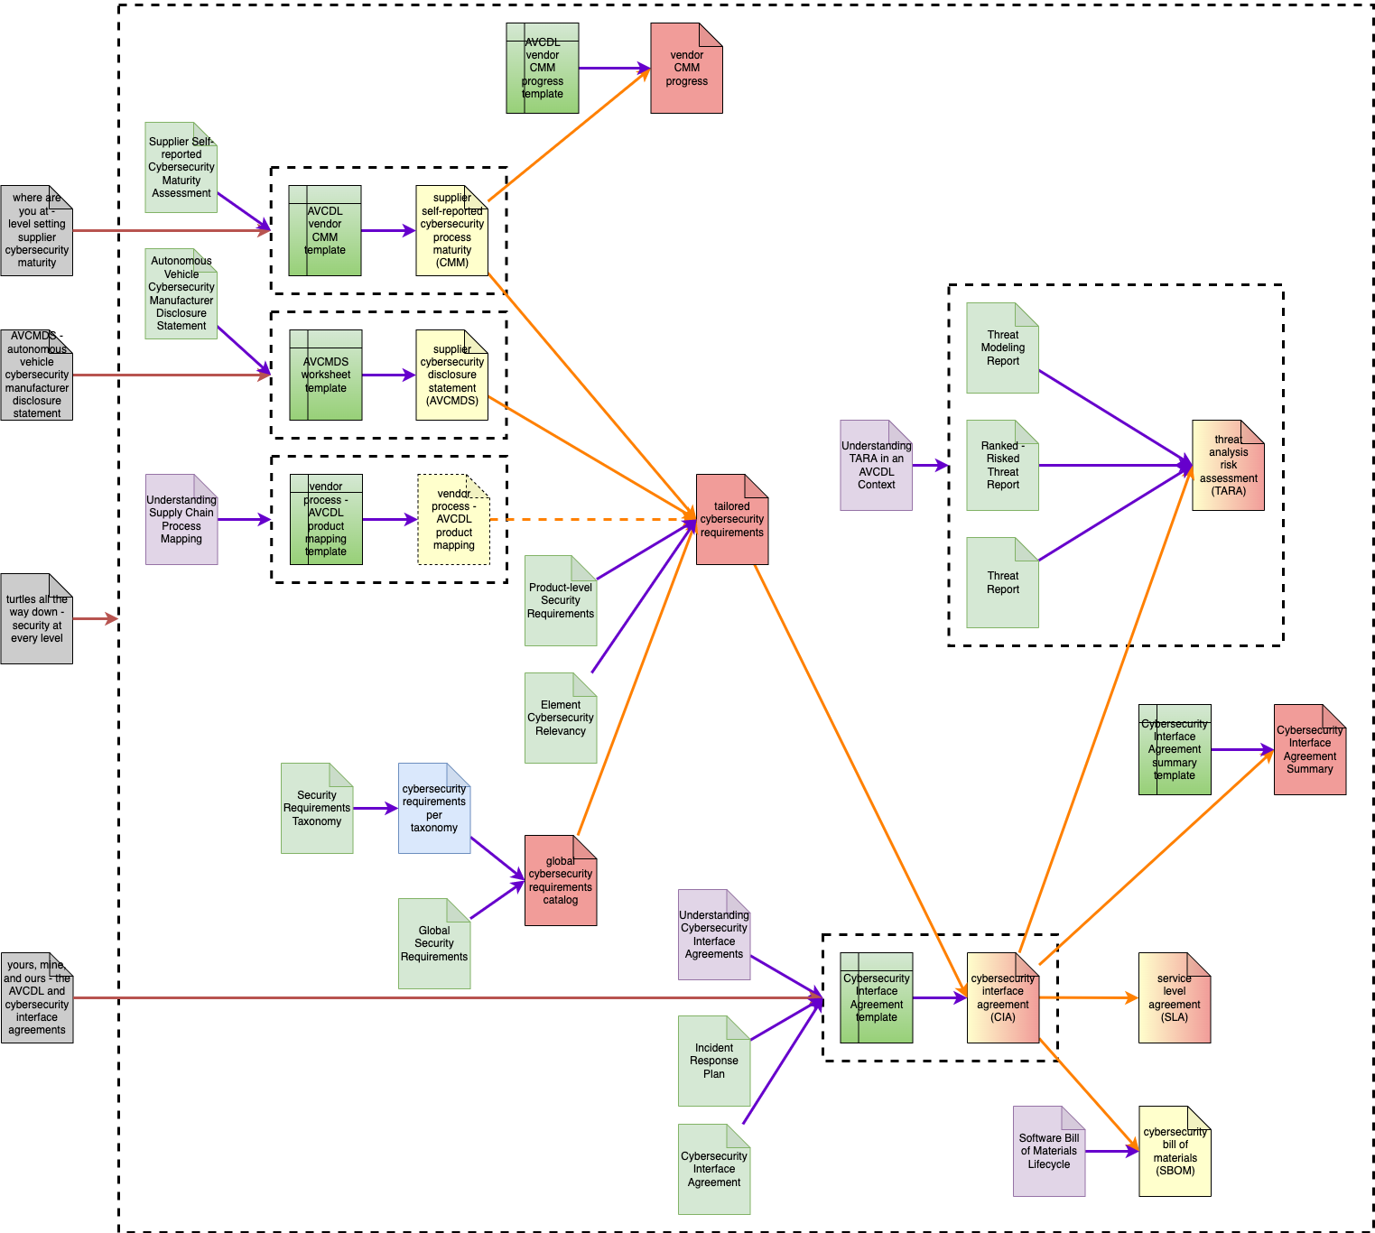
Supply Chain Guidance Documents
Notes:
Script:

Slide 27
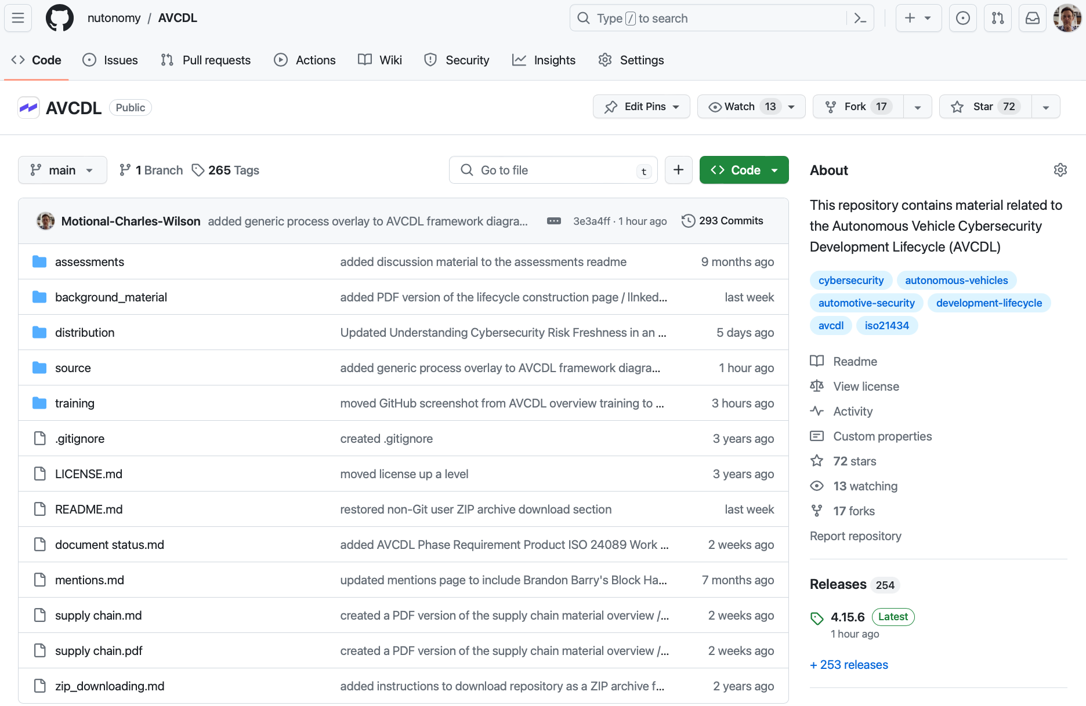
AVCDL on GitHub
https://github.com/nutonomy/AVCDL
Notes:
Script:
All AVCDL materials, both in source and distribution forms, are available on our GitHub site, as shown here.
Because of the size of the repository, it's recommended that you either clone the repository or download a zip archive of it if you're not familiar with using Git. Instructions for downloading a ZIP archive are linked to on the repository’s front page.

Slide 28
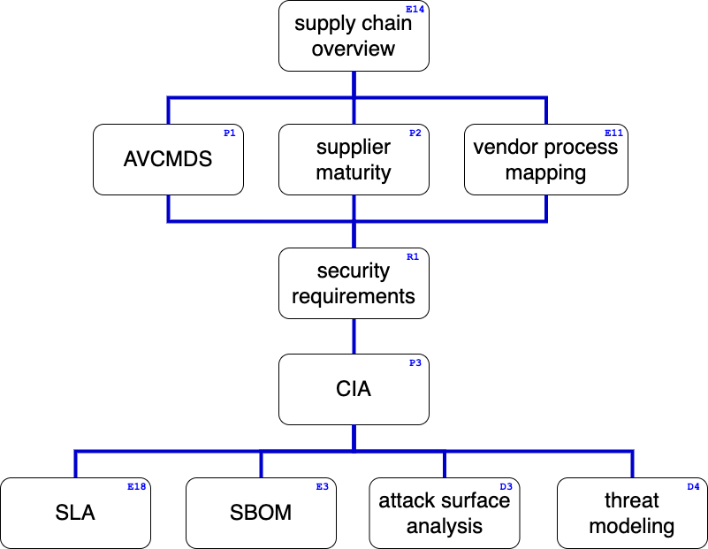
Supply Chain Training Path
Notes:
Script:
This diagram shows the overall AVCDL supply chain training path.

Slide 29
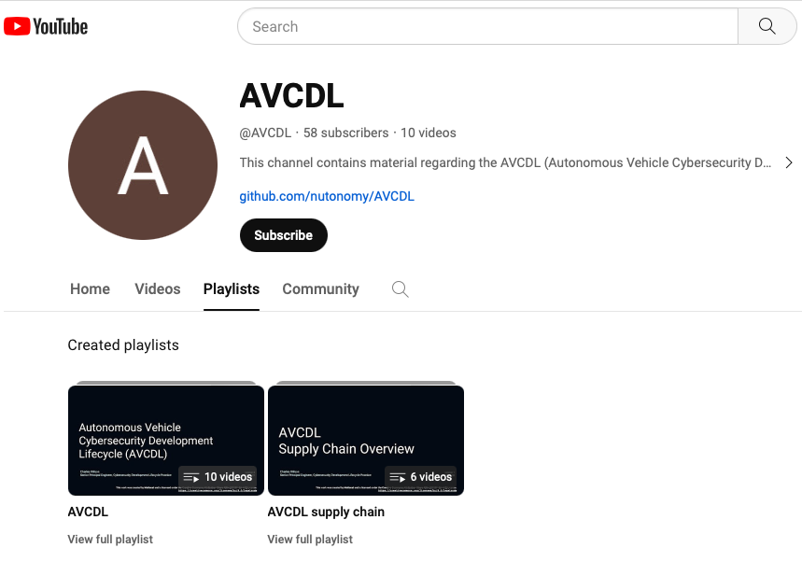
AVCDL on YouTube
https://youtube.com/@AVCDL/playlists
Notes:
Script:

Slide 30
Questions
Notes:
Script:

Slide 31
References (1 of 3)
AVCDL (GitHub)
https://github.com/nutonomy/AVCDL
AVCDL (YouTube)
https://youtube.com/@AVCDL
Autonomous Vehicle Cybersecurity Manufacturer Disclosure Statement (AVCDL secondary document)
Supplier Self-reported Cybersecurity Maturity Assessment (AVCDL secondary document)
vendor process - AVCDL product mapping template (AVCDL template document)
Understanding Supplier Cybersecurity Process Mapping (AVCDL elaboration document)
Understanding Supply Chain Interaction in an AVCDL Context (AVCDL elaboration document)
AVCMDS: Autonomous Vehicle Cybersecurity Manufacturer Disclosure Statement (AVCDL blog post)
AVCDL CMM template (AVCDL template document)
AVCDL cybersecurity interface agreement summary template (AVCDL template document)
Notes:
Script:

Slide 32
References (2 of 3)
Road vehicles – Cybersecurity engineering
https://www.sae.org/standards/content/iso/sae21434/
Road vehicles – Software update engineering
https://www.iso.org/standard/77796.html
UN Regulation No. 155 - Cyber security and cyber security management system
https://unece.org/transport/documents/2021/03/standards/un-regulation-no-155-cyber-security-and-cyber-security
UN Regulation No. 156 – Software update and software update management system
https://unece.org/transport/documents/2021/03/standards/un-regulation-no-156-software-update-and-software-update
UN Regulation No. 157 – Automated Lane Keeping Systems (ALKS)
https://unece.org/transport/documents/2021/03/standards/un-regulation-no-157-automated-lane-keeping-systems-alks
laying down rules for the application of Regulation (EU) 2019/2144 of the European Parliament and of the Council as regards uniform procedures and technical specifications for the type-approval of the automated driving system (ADS) of fully automated motor vehicles
https://eur-lex.europa.eu/legal-content/DA/TXT/?uri=PI_COM:Ares(2022)2667391
Notes:
Script:

Slide 33
References (3 of 3)
Capability Maturity Model
https://en.wikipedia.org/wiki/Capability_Maturity_Model
ISO/IEC 21827 - Information technology — Security techniques — Systems Security Engineering — Capability Maturity Model® (SSE-CMM®)
https://www.iso.org/standard/44716.html
CMM level and CMM Sweet Spot images (CC BY-ND 4.0)
https://www.securecontrolsframework.com/sp-cmm
Notes:
Script:

